Slide 1

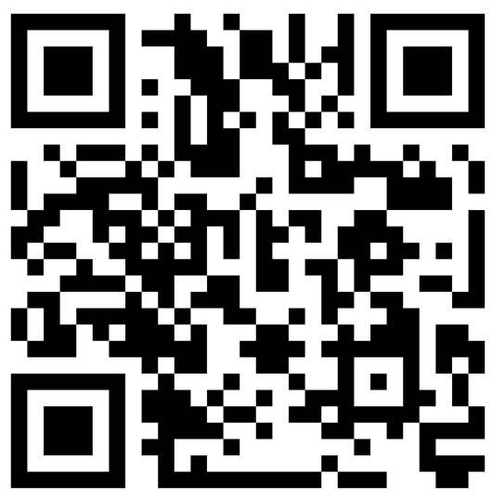

Climate, Models, and Finance Workshop
UCL 4th September 2025
Using Prediction Markets for Climate Related Risks
Mark Roulston and Kim Kaivanto
Lancaster University Management School

Slide 2


Information asymmetry in climate forecasting
It takes years to establish statistically meaningful track records for long-range forecasts.
Users must pick a provider without performance metrics.
Buyers won’t pay for quality they can’t verify.
Sellers won’t invest in quality they can’t demonstrate.
“Death spiral” of falling quality and prices.
Counteracting institutions:
Branding/chains
Licensing/standards
Guarantees/warranties
Notes:
The market for climate analytics and forecasts exhibits quite an extreme form of what economists call “information asymmetry” in which sellers know more about the quality of the product than buyers. With short-range weather forecasts, for a few days ahead, it might only take a few months for a forecaster to establish a statistically meaningful track record to demonstrate skill. For seasonal forecasts, with horizons of months, it can take years and for climate forecasts with horizons of decades it is essentially impossible for providers to use out-of-sample track records to show they know what they’re doing. This means users must select a provider without evidence of their quality, this is the “information asymmetry”.
The classic paper on information asymmetry was written more than fifty years ago by the economist George Akerlof who went on to win the Nobel Prize in Economics specifically for his contributions to analysing markets with asymmetric information. The example he used in his 1970 paper was for used cars, and since the Americans refer to dodgy used cars as “lemons” these markets have become known as “markets for lemons”.
One of Akerlof’s insights was that if buyers can’t verify a product is of above average quality they won’t be prepared to pay an above average price. But also, if sellers know they can’t get an above average price they have no incentive to sell above average products. Because of this it’s possible for a market to enter a so-called “death spiral” of falling quality and falling prices.
Akerlof identified several institutions that counteract this vulnerability to market failure. The two that are probably most relevant for climate analytics are licensing and standards and guarantees and warranties.

Slide 3
Regulatory standards and certification
Can enhance the credibility of providers.
Can reduce variability in quality.
Can promote established best practice.
Can allow sanctions for low quality (e.g., withdrawal of certification).
Who sets and certifies the standards and accreditation?
Can create barriers to entry protecting incumbents (e.g., NRSROs).
Can reduce pluralism and innovation.
How to accommodate proprietary (“black box”) methods?
Notes:
One class of institutions to mitigate information asymmetry is licensing, standards, and certification. This can enhance the credibility of providers and reduce the variability in the quality of what they provide. Regulatory standards can promote best practice, assuming that there is agreement on what best practice entails. This might not be the case in fields that are rapidly developing, and climate forecasting is possibly in such a phase with the advent of approaches based on machine learning and so on. Certification can also allow poor quality to be sanctioned by withdrawing the certification.
A big question, however, is who gets to set and certify these standards? A lot of the necessary expertise for doing this for climate forecasts and analytics will reside within the current providers of these services. This poses a problem, because if providers have a big say in the setting of the standards they can be used to create barriers to new entrants. For example, professional licensing bodies, and before that medieval guilds, have been criticized as acting like cartels and engaging in anti-competitive behaviour. A similar argument has been made about the system of Nationally Recognized Statistical Rating Organizations, the system for regulating credit rating agencies.
The new entrants that will face the highest barriers will be those that want to use alternative methods. I mentioned that standards can reduce variability in quality, but this is a two-edged sword because they achieve this by reducing diversity in approaches, inhibiting pluralism and innovation.
Another question is how would a standards and certification framework deal with proprietary or “black box” methods that providers don’t want to expose. In short-range weather forecasting this would be less of an issue: if you have a statistically robust track record of accurate forecasts, I might buy the forecasts with no knowledge of how you are achieving it. But for longer-range predictions that track record is unlikely to be available.

Slide 4
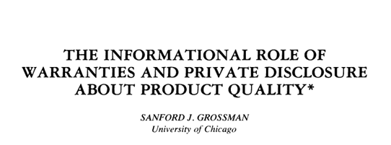
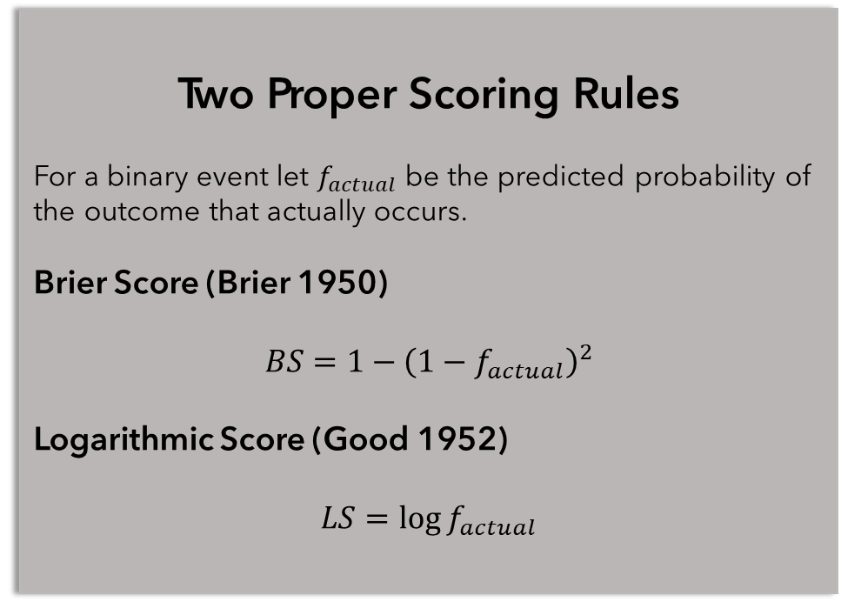
Guarantees and warranties
Warranties expose provider to risk and let them signal confidence.
How do you design a warranty for a probabilistic forecast?
Closely connected to scoring rules and incentive compatibility.
The expected value of a proper scoring rule is maximized by reporting your true probability, it is incentive compatible.
Proper scoring rules penalize overconfidence and understatement of uncertainty.
Two Proper Scoring Rules
For a binary event let $f_{actual}$ be the predicted probability of the outcome that actually occurs.
Brier Score (Brier 1950)
$$BS=1−{\left(1−f_{actual}\right)}^{2}$$
Logarithmic Score (Good 1952)
$$LS=\log{f_{actual}}$$
Notes:
An alternative to prescriptive regulations is for providers to offer credible guarantees or warranties. The reputation of used-car salespeople today is arguably much better than it was when Akerlof wrote his original paper and a lot of the reason for this can be put down to used cars coming with money-back guarantees. Some of these guarantees are now required by law – so this is a type of regulation in the most general sense – but many dealers also offer non-statutory warranties because this allows them to charge more for high quality vehicles.
The problem of designing warranties for probabilistic forecasts is closely connected to designing scoring rules for probabilistic forecasts – something for which there’s a literature going back to the 1950s – and these are also connected to the concept of “incentive compatibility” from economics.
A key characteristic of a good probabilistic scoring rule is that it should be “proper”: this means you maximize its expected value by reporting your true beliefs about the probabilities of possible outcomes. A proper score cannot be gamed. Examples of proper scoring rules are the Brier score, a favourite in meteorology, and the logarithmic score, which has a close connection to information theory.
With proper scoring rules, we can design incentive schemes for forecasters which motivate them to be truthful, and this truthfulness can include acknowledging their uncertainty and not degrading a baseline forecast if they are uninformed.

Slide 5
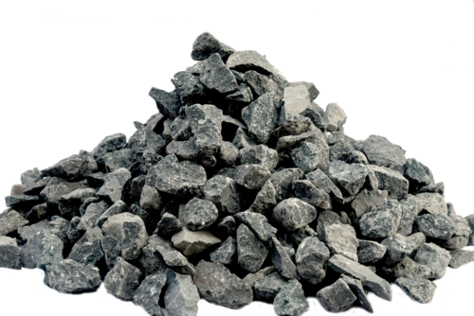

Selection or synthesis?
Provider compensation can be made incentive compatible.
But which provider to choose?
Buying multiple forecasts means paying for duplicated information.
Do we want the best forecaster or the best forecast?
Combining information from multiple providers can improve forecasts.
Aggregation is not straightforward, assumptions about independence are necessary.
Notes:
The compensation of providers of climate forecasts can be made incentive compatible, we can incentivize them to be truthful, including about their own uncertainty, but this might still leave us with the problem of having to choose between multiple providers who might all be offering credible warranties.
But do we want to even choose a single provider? As a decision maker you shouldn’t really be interested in identifying the best forecaster but in having the best forecast, which could well be a synthesis of information from multiple providers. So instead of how to choose, we should think about how to aggregate.
Aggregating probabilistic forecasts is not straightforward. Any aggregation method has to make assumptions about the independence of the forecasts – remember Wittgenstein’s joke about buying multiple copies of the morning newspaper to assure what it says is true. Providers might have views on how independent their information is compared to other providers, but this is the kind of tacit knowledge which can be hard to capture in a structured way.
Also, beyond the methodological questions about aggregation there’s an efficiency question: If I buy half a dozen forecasts to aggregate them it’s likely that a significant component is going to be common across all the forecasts, in which case I’ve just paid multiple times for the same information. Ideally, I only want to pay for information in a forecast that is not already contained in a forecast I’ve already paid for.

Slide 6
Prediction markets are based on contingent securities.
Prediction markets
I.O.U. £1.00 if event X occurs
Harness the ability of markets to aggregate information.
Can combine diverse modelling approaches and tacit expertise.
Can outperform other methods (e.g., expert surveys).
Standardize the deliverable but are agnostic on methods.
Can be based on proper scoring rules.
Expected value = £1.00 × Prob(X)
If price = expected value then Prob(X) = price
The securities are traded to discover a price which can respond to new information.
Notes:
Prediction markets are a mechanism that can simultaneously incentivize accurate forecasting and aggregate multiple forecasts into a collective or consensus forecast. Lots of markets, like stock markets and commodity futures markets can reveal and aggregate information but for prediction markets this is their primary function, rather than the transfer of assets or risks.
In other fields prediction markets have been found to outperform other expert elicitation methods, such as surveys, and they have the advantage of being to incorporate information in real-time rather than providing snapshots. They require standardization of the deliverable – everyone has to know and agree on exactly what is being predicted – but prediction markets are completely agnostic on the methods used.
Most prediction markets are based on contingent securities, for example an IOU that pays out £1.00 if it snows in London on Christmas Day. These securities are traded and if we assume the prevailing price matches the expected value of the security then the price can be interpreted as a probability – according to the collective wisdom of the participants.

Slide 7
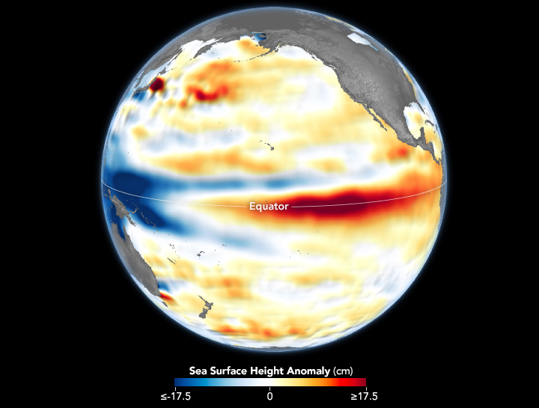
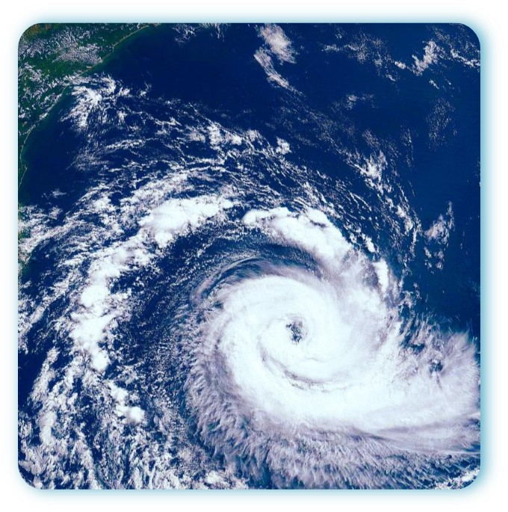
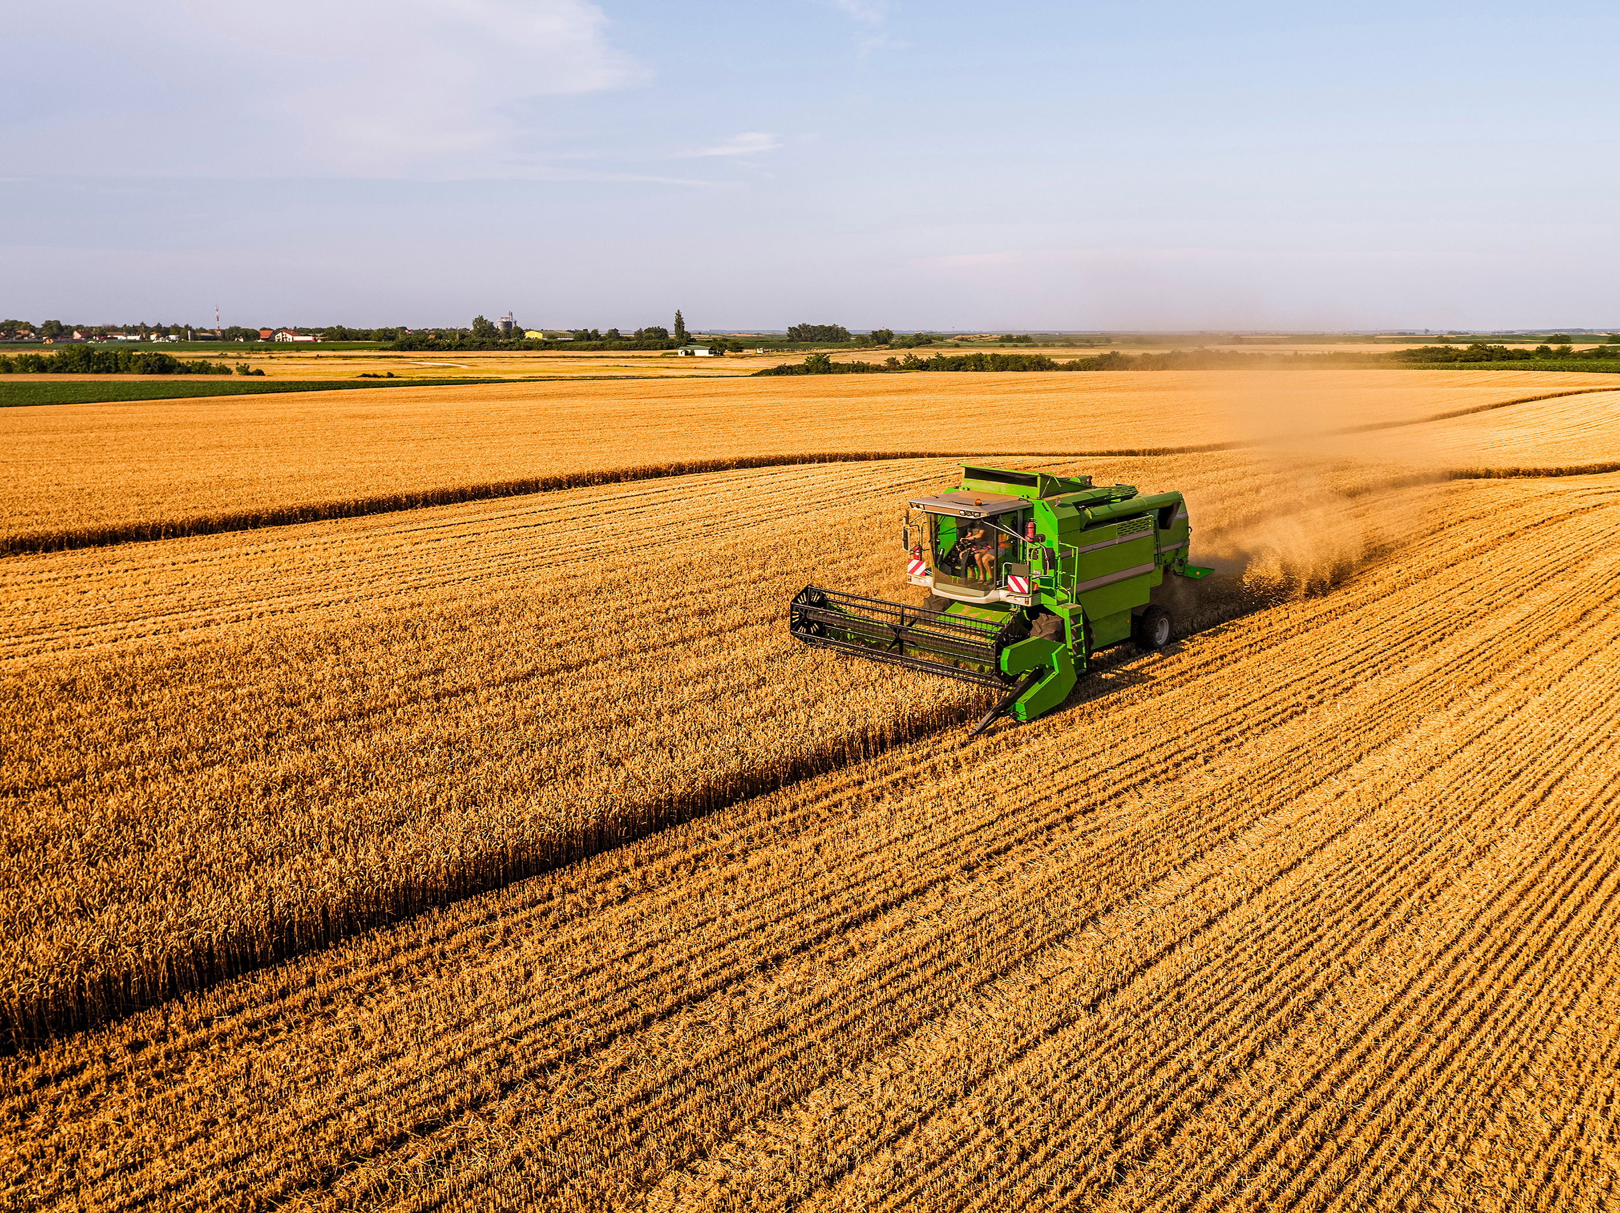


CRUCIAL
Climate Risk and Uncertainty Collective Intelligence Aggregation Laboratory
CRUCIAL uses prediction markets to aggregate climate expertise.
CRUCIAL prediction markets…
…are not “pay-to-play”
…have expert participants from academia and the private sector.
…use an automated market maker (AMM) to ensure liquidity.
…reward participants using the logarithmic score for incremental contributions accuracy.
…can be used for physical climate risks and GHG emissions/concentrations.
El Niño/La Niña
Atlantic hurricanes
Crop yields
UK rainfall
UK temperature
Notes:
The CRUCIAL initiative has been using prediction markets as a way to aggregate climate forecasting expertise. The prediction markets run by CRUCIAL are not “pay-to-play” markets – we are not running an online gambling site. Instead, participants are invited for their expertise and allocated on-platform credits with which to trade. The market uses an automated market making algorithm which rewards participants for the marginal improvements they make to the collective forecast, that is it rewards them for accurate information that has not already been incorporated into the market prices.
This is a market we are currently running to predict the total number of hurricanes that will occur during this year’s Atlantic hurricane season. It’s a nice example to illustrate the general concept but the idea can of course be applied to many other types of climate-related risks. There is a set of outcomes. In this case ranging from no hurricanes to an outcome covering 20 or more hurricanes. Each outcome has a price set by the automated market maker based on its relative popularity using an algorithm based on the logarithmic score. Participants can define contracts covering one or more outcomes that the market maker will price. The prices can be interpreted as probabilities so if the quoted price is higher than the participant’s estimate of the relevant probability they have an incentive to buy, raising the price. When you buy one of these outcomes it’s equivalent to fixed odds betting: if I buy a contract for 0.25 credits that will pay out 1.00 credit if the outcome occurs that’s the same as placing a bet at 3:1 odds. But I can sell the contract back to the market maker at any time, which is how these markets incorporate new information as it becomes available.
We are currently running other markets, similarly structured, for the value of the Relative Oceanic Nino Index out to early 2027.

Slide 8
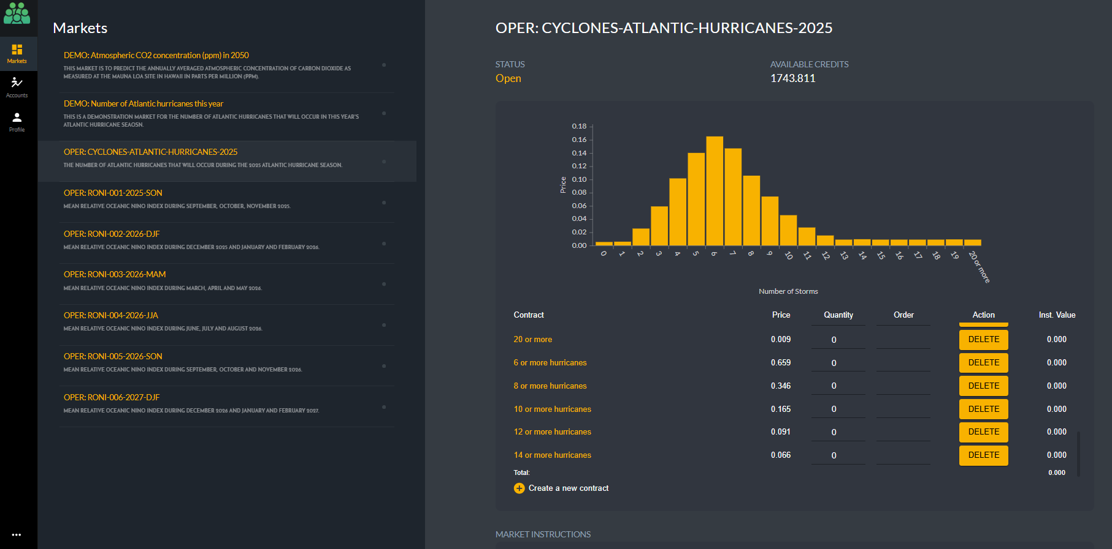
Prices can be interpreted as probabilities: e.g., 16.6% chance of 6 hurricanes.
Currently running markets for Atlantic hurricanes and and El Niño-Southern Oscillation.
Participants can define contracts covering one or more outcomes.

Slide 9
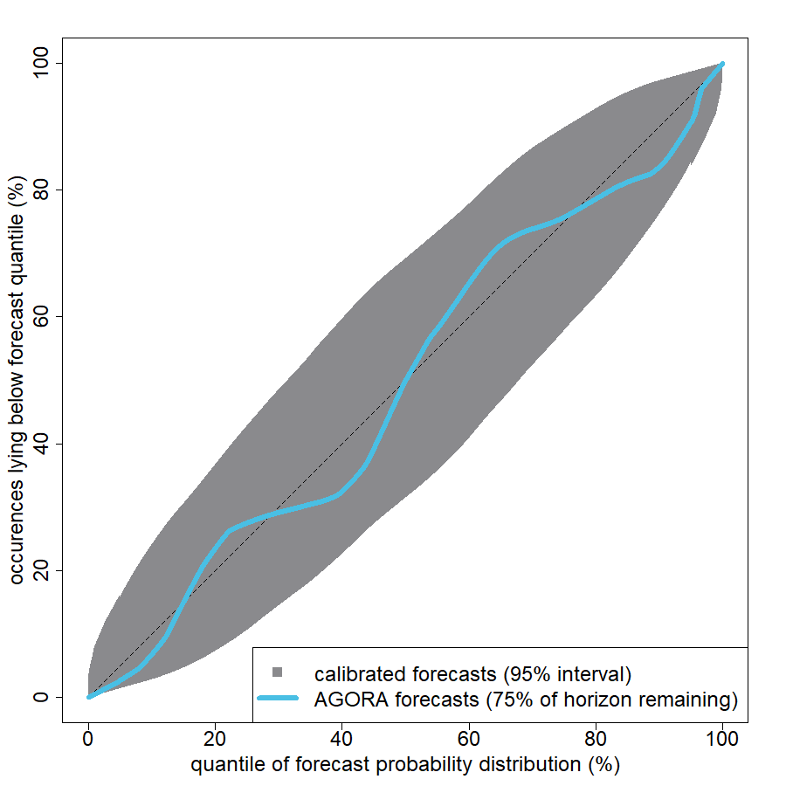




How accurate are market-based forecasts?
curves inside the grey envelope are consistent with perfect calibration
Probability forecasts should be calibrated: Frequencies of outcomes should match predicted probabilities.
Prediction market forecasts for climate risks made using expert participants are consistent with good calibration.
Roulston and Kaivanto. "Can expert prediction markets forecast climate-related risks?." Bulletin of the American Meteorological Society 105.10 (2024): E1898-E1914.
Notes:
Over the past six years we’ve run a couple of dozen prediction markets, with expert participants, for climate-related topics such as monthly temperatures and rainfall in the UK, El Nino-Southern Oscillation, Atlantic hurricane activity and crop yields. These markets had prediction horizons ranging from a couple of months to around one year. With 24 verified forecasts we can start to ask how accurate are the probabilities implied by the market prices. If probability forecasts are well calibrated the actual outcome should fall below the 10th percentile of the forecast distribution for 10% of verifications, below the 20th percentile for 20% of the verifications and so on. A plot of the percentage of outcomes that fall below each percentile should be a diagonal line. The blue line is this calibration curve for the 24 forecasts. The grey zone is an envelope of calibration curves for synthetic verifications which were drawn from the forecast distributions, in other words for forecasts that were perfectly calibrated by construction. The blue line lies inside the envelope meaning that this sample of 24 verified forecasts is consistent with being perfectly calibrated.
There are a couple of caveats on this result: first 24 forecasts isn’t a large sample. When prediction horizons are measured in months it takes a while to build up a sample of verified forecasts. With a large sample the grey envelope would be narrower, potentially revealing meaningful deviations from perfect calibration. The other caveat is that the longest horizon for any of these forecasts was only about one year, whether good calibration will be seen on longer time scales is something we can only know by running markets for longer-range forecasts. Of course, both of these caveats apply to all long-range climate forecasts, not just those generated using a market mechanism.

Slide 10













Climate Forecast Users
reinsurance
agriculture
public sector
financial sector
infrastructure
User Steering Group
Aon, Howden,
JBA Trust, WTW
Teams from 8 UK universities, 2 US universities, and a private-sector forecasting firm are in the consortium of participants in CRUCIAL’s prediction markets.
Notes:
The CRUCIAL project is now in its next phase, with funding from the Corporate Foundation of the French reinsurer SCOR. In this phase we are moving beyond one-off pilot markets towards making prediction markets a permanent institution for aggregating climate expertise.
Up to now all the markets we have run have had prediction horizons of up to about one year, but we want to run markets at a wide range of horizons, from seasonal forecasts all the way, ultimately, to multidecadal horizons relevant to climate change. This will introduce challenges that most prediction markets don’t have to contend with, but none that haven’t been overcome in other contexts.
We have brought together teams of experts at universities, and from the private sector, to collaborate by participating in prediction markets for climate risks, and to be involved in the governance of these markets.

Slide 11
Summary
Market for climate analytics and forecasts exists and is growing.
The market wasn’t designed.
It is vulnerable to market failure.
Want to avoid prescriptive standards about methods.
The market could benefit from insights from mechanism design.
Positive-sum prediction markets need a sponsor to fund them.
Prediction market forecasts are public goods (non-rival and non-excludable).
Public funding is one option.
Alternatives include assurance contracts.
Choice of market topics could influence research priorities.
Notes:
A market for climate analytics and forecasts already exists, and it’s growing. But this market is an ad hoc market that hasn’t been designed. Because of the information asymmetries that are intrinsic to long-range climate prediction, the market is vulnerable to a text-book type of market failure.
When the primary deliverable is a forecast – probabilistic of course, then the market could be improved by formally designing it, using insights from mechanism design. This does entail a type of regulation, but it’s preferable to prescriptive standards about models and methods because those types of standards are likely to create barriers to pluralism and innovation.
While providers of climate forecasts would interact with this type of market by trading in prediction markets, there is a question of how users and buyers of climate forecasts would interact with a market like this. Organisations that need information can sponsor markets, so it is a bit like an X-Prize for climate forecasting, except the market mechanism allows the prize to be distributed in direct proportion to contributions to forecast accuracy.
But who should sponsor the markets? One issue is that the collective forecasts produced by prediction markets typically fit the economist’s definition of a public good: They are “non-rival” – if one person gets a forecast it doesn’t prevent someone else from getting it too – and “non-excludable” because it’s not easy to restrict access only to those who have paid.
Now the government, through science funding agencies, already pays for climate forecasting as a public good and there is no fundamental reason why some of this couldn’t be allocated using a market mechanism – although it be might be a bit radical. However, when it comes to private sector buyers of climate forecasts the non-excludability becomes an issue as competitors could free-ride and benefit from forecast that they have not paid for.
There are alternatives to public funding for public goods, such as assurance contracts in which all members of a group agree to contribute conditional on the other members of the group contributing and these are worth exploring.
Prediction markets could essentially become a new type of scientific institution and, as sponsorship grows, they could influence research priorities.

Slide 12
Supplementary Slides

Slide 13
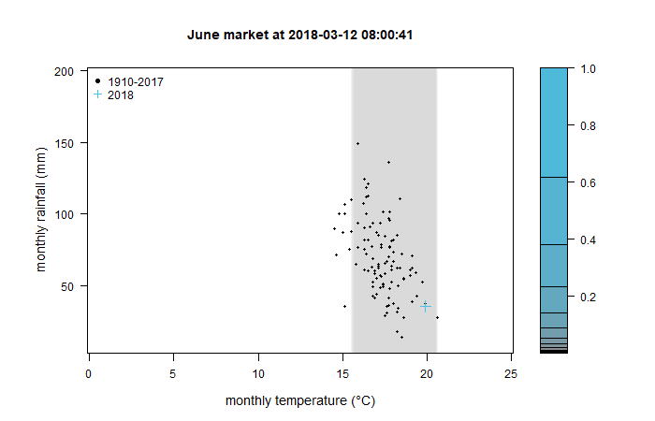
A 2D market: monthly temperature and rainfall
simultaneous prediction of UK monthly temperature and rainfall
space divided into 5,207 outcomes (0.2°C x 5mm)
6 markets: April, May, June, July, August, September 2018
all markets opened in March 2018
24 teams from UK universities endowed with virtual credits
teams accumulating most credits received rewards totaling £55,000 (courtesy of Winton Group)
demonstrated viability of granular two-dimensional markets.
Roulston and Kaivanto. "Joint-outcome prediction markets for climate risks." PloS one 19.8 (2024): e0309164.

Slide 14
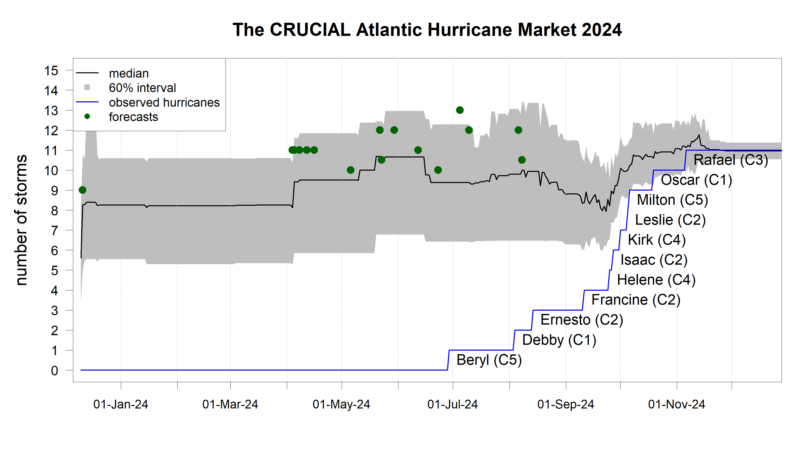
Forecasting groups predicted a very active season
Unusually quiet period occurred in late August and early September
Roulston, Kaivanto and Toumi. "Tracking evolving views of the 2024 Atlantic hurricane season with an expert prediction market.“ Weather (2025).

